Slide 2
Object Detection &
Traffic Signs Recognition

Slide 3
Table of Contents
01
Overview
02
Ultralytics and Models
03
Why YOLO?
04
YOLO Versions
05
Training Object Detection Flowchart
06
Result Object Detection Flowchart
07
Roboflow & Datasets
08
TSR Flowchart
09
Future Application

Slide 4

01
Overview
Object detection is a computer vision technique that enables machines to recognize, locate, and classify multiple objects within an image.

Slide 5


02
Ultralytics and Models
Ultralytics is an intuitive AI platform for creating, training, and deploying machine learning models with a no-code interface and deep learning framework support.
Ultralytics HUB is designed to be user-friendly and intuitive, allowing users to quickly upload their datasets and train new YOLO models.

Slide 6
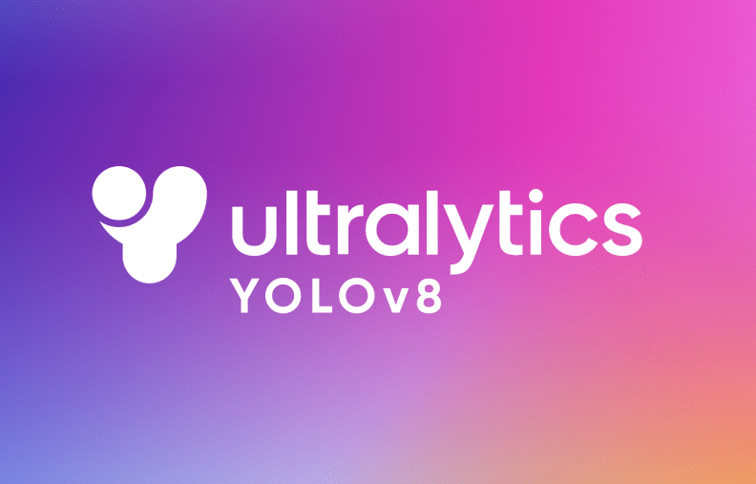
03
Why YOLO?
YOLO (You Only Look Once) is a state-of-the-art real-time object detection system that revolutionized the way objects are detected in images and videos.

Slide 7
04
YOLO Versions
1
3
YOLOv2 (2017): Known as YOLO9000, improved version in accuracy and performance like batch normalization and the Darknet-19 backbone.
YOLOv4 (2020): YOLOv4 introduced new techniques, like CSPDarknet53, making it faster and better at handling complex tasks.
YOLO started in (2016) by Joseph Redmon and Santosh Divvala introduced a new way of detecting objects.
YOLOv3 (2018): This version introduced multi-scale predictions, allowing it to detect objects of different sizes more effectively.
2
4
8
6
YOLOv7 (2022): Created by Chien-Yao Wang, brought faster and more accurate object detection through an improved backbone.
YOLOv5 (2020): YOLOv5 developed by Ultralytics, became famous for its ease of use and better training features.
YOLOv8 (2023): YOLOv8, created by Glenn Jocher and Ultralytics. It uses cutting-edge deep learning techniques that make it ideal for tasks like autonomous driving and advanced security systems
YOLOv6 (2022): Released by Meituan, YOLOv6 made further improvements in speed and efficiency.
7
5

Slide 8
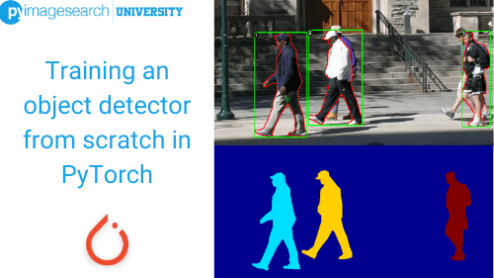
05
Training Object Detection Flowchart
Start
Load YOLO model & choose model type
Configure Parameters
Train model
(set training data, epochs, img size and device)
Evaluate model skip evaluation on validation set
End

Slide 9
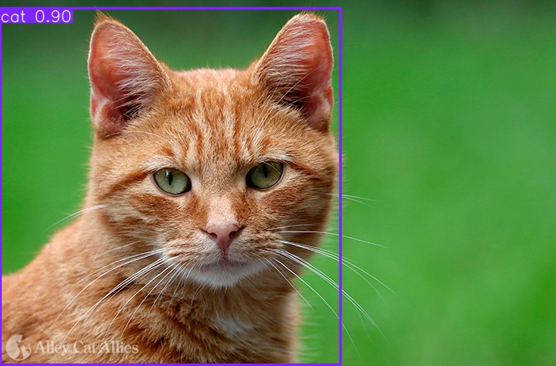
06
Result Object Detection Flowchart
Start
Load YOLO model & choose model type
- Configure Object
- Detection Parameters (Input source, Confidence threshold, Display & save options)
Perform Object Detection
(Run on chosen source)
Perform Object Detection
(Run on chosen source)
End

Slide 10

07
Roboflow & Datasets
Roboflow is a tool that eases the computer vision task in the field of deep learning. It empowers developers to build their computer vision applications, no matter their skill set or experience. It supports object detection and classification models.

Slide 11
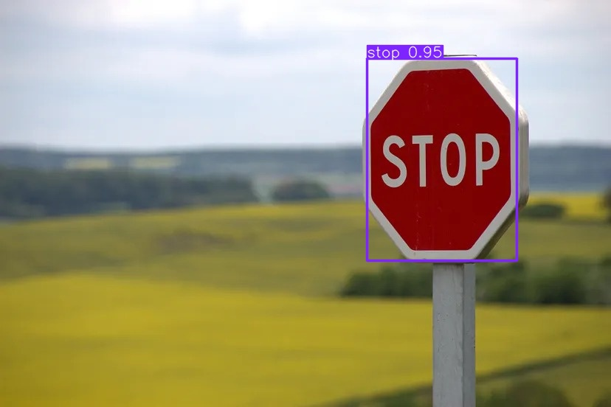
08
TSR Flowchart
Start
Load custom YOLO model
(e.g. best.pt)
Configure Detection Parameters (Input source, Confidence threshold, Display & save options)
Perform Object Detection
(Run on chosen source or apply on chosen images)
Show the Results and Save it if needed
End

Slide 12
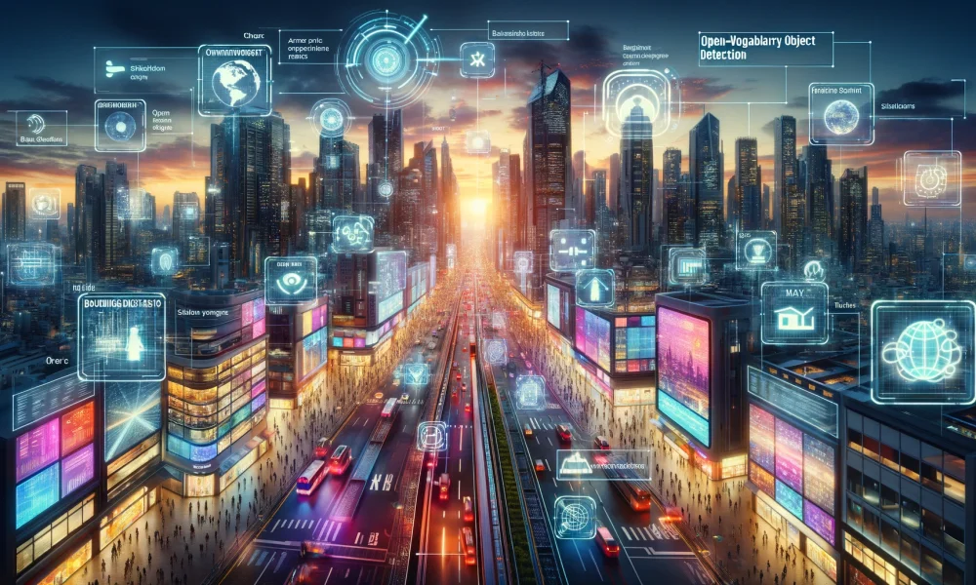
09
Future Application
The future of object detection technology is looking bright, as it has the potential to transform various industries by automating manual tasks and creating new, AI-powered products and services.
Medical Imaging
Retail
Sports Analytics

Slide 13
Thank You
Any Questions?

